Slide 1
STOR 455 Simple Linear Models
Read: 1.1-1.6
Exercises: #1.3, 5, 7, 9, 15, 17, 21, 23, 25

Slide 2
Single Quantitative Predictor Model
Notation: Y = Response variable
X = Predictor variable
Assume (for now) that both Y and X are quantitative variables.

Slide 3
Simple Linear Model
X = Single quantitative predictor
Y = Quantitative response
Find a line that best summarizes the trend in the data.
Y
X

Slide 4
Simple Linear Model
response
random error
Y = β_{o} + β₁X + ε
intercept
predictor
slope
Assume: ε ~ N( 0, σ_{ε}) and independent
Three parameters to estimate: β_{o}, β₁, σ_{ε}

Slide 5
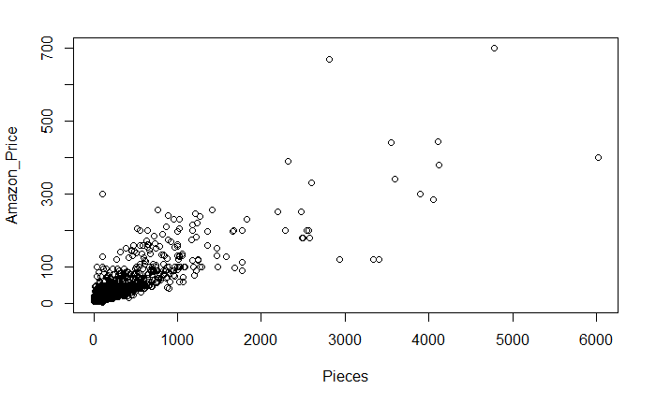
Scatterplot in R
plot(Amazon_Price~Pieces, data=lego)

Slide 6
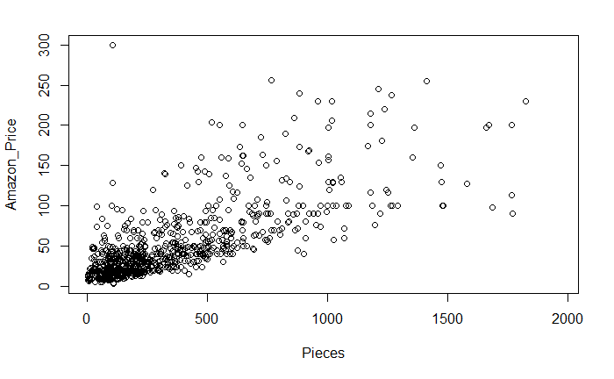
Scatterplot in R
lego_under_2k_pieces = subset(lego, Pieces < 2000)
plot(Amazon_Price~Pieces,data=lego_under_2k_pieces)

Slide 7
Least Square Regression in R
Syntax: lm(Response~Predictor,data= )
lm(Amazon_Price~Pieces, data=lego_under_2k_pieces)
Call:
lm(formula = Amazon_Price ~ Pieces, data = lego_under_2k_pieces)
Coefficients:
(Intercept) Pieces
15.3174 0.1023
$$\hat{Amazon_Price}=15.3174+0.1023(Pieces)$$

Slide 8

R – Plot with Fitted Line
mod1=lm(Amazon_Price~Pieces, data=lego_under_2k_pieces)
plot(Amazon_Price~Pieces, data=lego_under_2k_pieces)
abline(mod1)

Slide 9
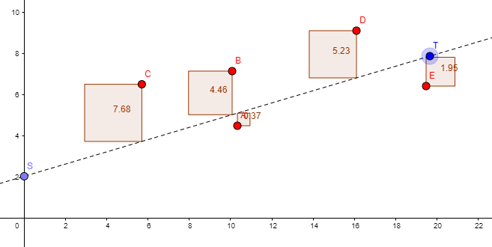
Simple Linear Model
X = Single quantitative predictor
Y = Quantitative response
Interactive Regression Model

Slide 10
Simple Linear Model- Conditions
Model:
Linearity: The means for Y vary as a linear function of X.
Error:
Zero Mean: The distribution of the errors is centered at zero.
Constant variance: The variance for Y is the same at each X. (Homoscedasticity)
Independence: No relationships among errors.
Normality:
Residuals are normally distributed
(sometimes) At each X, the Y’s follow a normal distribution.

Slide 11
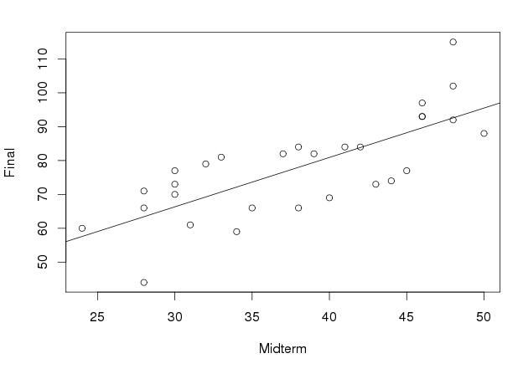
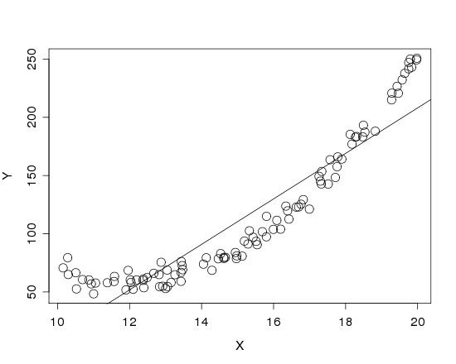


Is it Linear?
Look for consistent curvature or non-linear patterns

Slide 12
R – Plot with Fitted Line
mod1=lm(Amazon_Price~Pieces, data=lego_under_2k_pieces)
plot(Amazon_Price~Pieces, data=lego_under_2k_pieces)
abline(mod1)

Slide 13
Simple Linear Model- Conditions
Model:
Linearity: The means for Y vary as a linear function of X.
Error:
Zero Mean: The distribution of the errors is centered at zero.
Constant variance: The variance for Y is the same at each X. (Homoscedasticity)
Independence: No relationships among errors.
Normality:
Residuals are normally distributed
(sometimes) At each X, the Y’s follow a normal distribution.
?

Slide 14
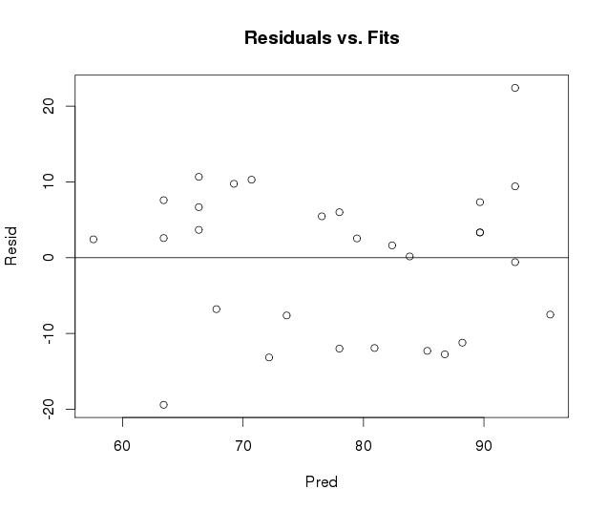
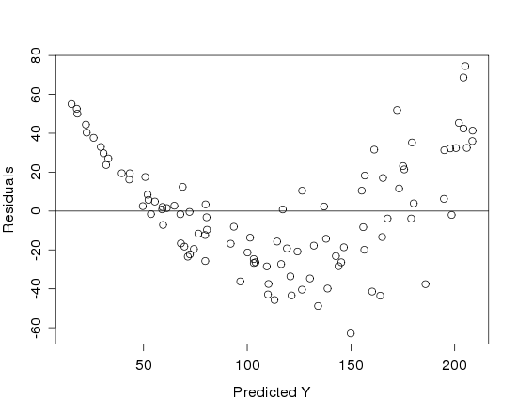

Is it Linear?
Plot the residuals vs. the predictions

Slide 15
More Regression in R
Save the results of the linear model in a variable:
mod1=lm(Amazon_Price~Pieces, data=lego_under_2k_pieces)
… then access information from the model
summary(mod1) #gives more information
mod1$residuals #contains residuals
mod1$fitted.values #contains fitted values

Slide 16
Model Summary in R
mod1=lm(Amazon_Price~Pieces, data=lego_under_2k_pieces)
summary(mod1)
Call:
lm(formula = Amazon_Price ~ Pieces, data = lego_under_2k_pieces)
Residuals:
Min 1Q Median 3Q Max
-106.507 -16.530 -6.963 8.183 274.033
Coefficients:
Estimate Std. Error t value Pr(>|t|)
(Intercept) 15.317375 1.603125 9.555 <2e-16 ***
Pieces 0.102304 0.003319 30.827 <2e-16 ***
---
Signif. codes: 0 ‘***’ 0.001 ‘**’ 0.01 ‘*’ 0.05 ‘.’ 0.1 ‘ ’ 1
Residual standard error: 31.35 on 802 degrees of freedom
(424 observations deleted due to missingness)
Multiple R-squared: 0.5423, Adjusted R-squared: 0.5417
F-statistic: 950.3 on 1 and 802 DF, p-value: < 2.2e-16

Slide 17
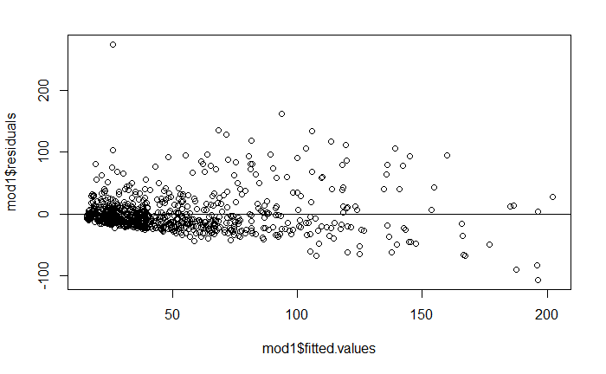
R – Plot with Fitted Line
plot(mod1$residuals~mod1$fitted.values)
abline(a=0, b=0)

Slide 18
Simple Linear Model- Conditions
Model:
Linearity: The means for Y vary as a linear function of X.
Error:
Zero Mean: The distribution of the errors is centered at zero.
Constant variance: The variance for Y is the same at each X. (Homoscedasticity)
Independence: No relationships among errors.
Normality:
Residuals are normally distributed
(sometimes) At each X, the Y’s follow a normal distribution.
?

Slide 19
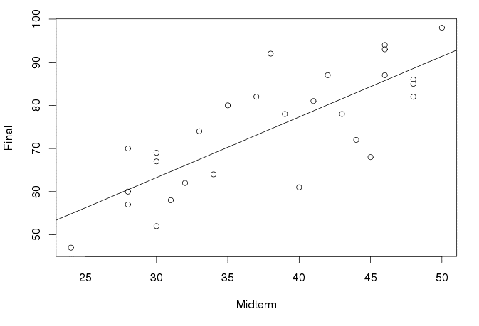
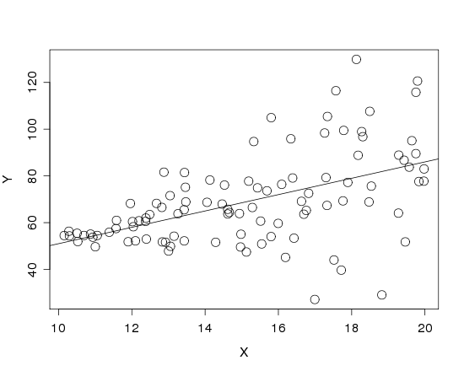
Is the Variance Constant?
Look at a scatterplot with the regression line drawn on it.
Look for “fan-shaped” pattern

Slide 20
R – Plot with Fitted Line
mod1=lm(Amazon_Price~Pieces, data=lego_under_2k_pieces)
plot(Amazon_Price~Pieces, data=lego_under_2k_pieces)
abline(mod1)

Slide 21
Simple Linear Model- Conditions
Model:
Linearity: The means for Y vary as a linear function of X.
Error:
Constant variance: The variance for Y is the same at each X. (Homoscedasticity)
Independence: No relationships among errors.
Normality:
Residuals are normally distributed
(sometimes) At each X, the Y’s follow a normal distribution.
?
?

Slide 22
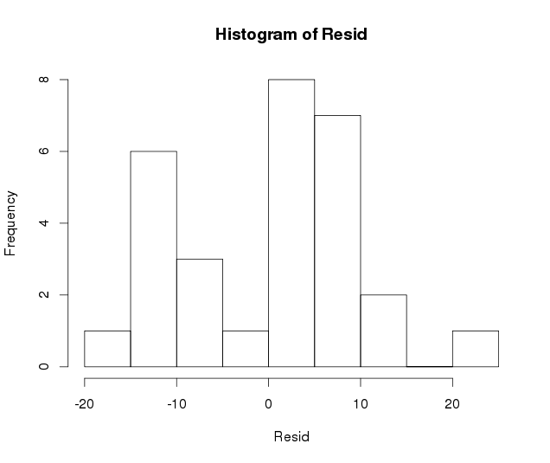
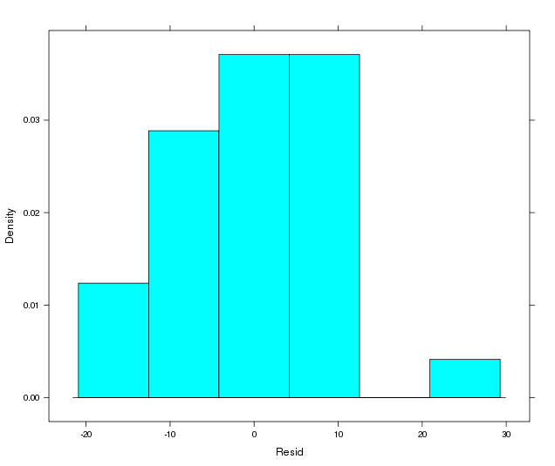
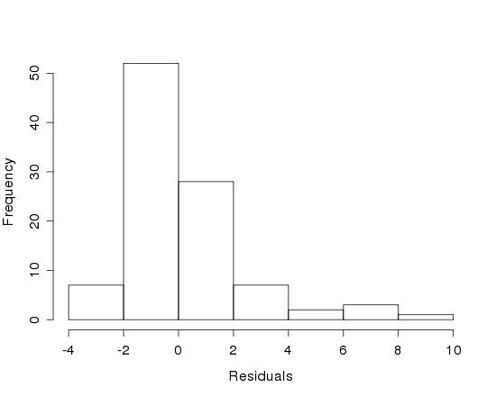
Are the Residuals Normal?
Look at a histogram of the residuals
?
Look for clear skewness and outliers

Slide 23
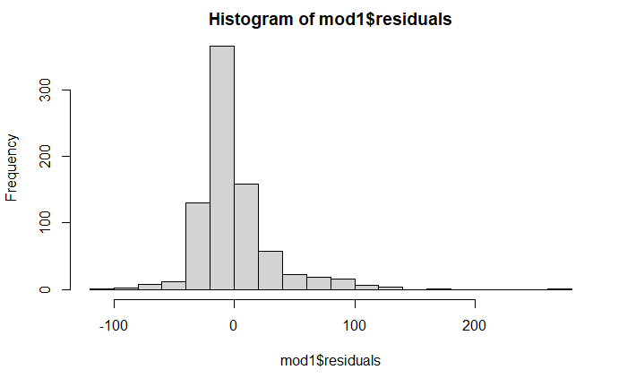
Are the Residuals Normal?
hist(mod1$residuals, breaks=20)

Slide 24
Are the Residuals Normal?
Look at a normal quantile plot
Scatterplot of residuals vs. a “perfect” normal sample.
Straight line ↔ Normal data

Slide 25
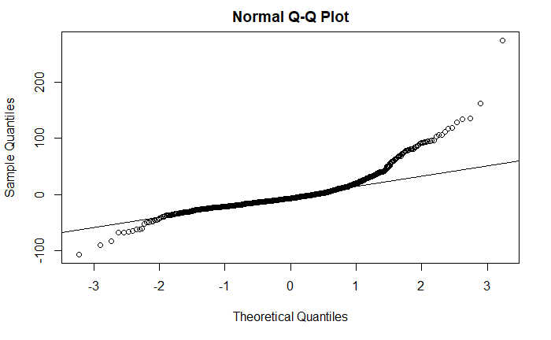
Are the Residuals Normal?
qqnorm(mod1$residuals)
qqline(mod1$residuals)

Slide 26
Simple Linear Model- Conditions
Model:
Linearity: The means for Y vary as a linear function of X.
Error:
Constant variance: The variance for Y is the same at each X. (Homoscedasticity)
Normality:
Residuals are normally distributed
(sometimes) At each X, the Y’s follow a normal distribution.
?
?
X

Slide 27
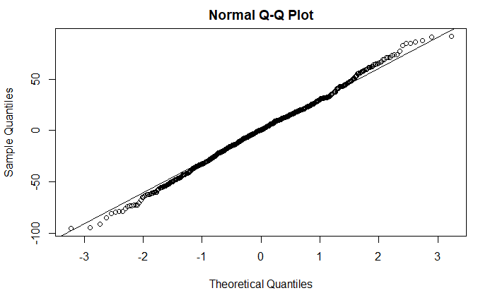
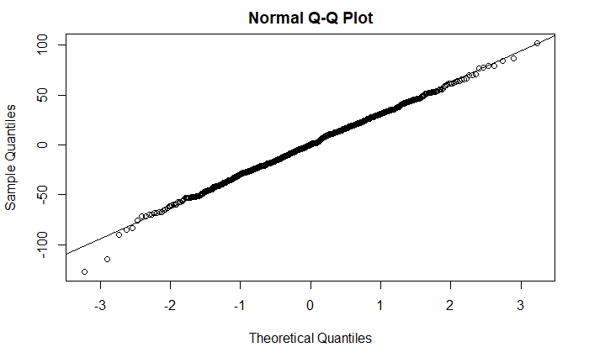
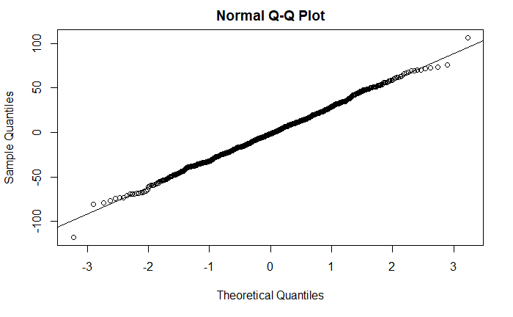
How much Variability is Expected?
x <- rnorm(804, 0, 31.35)
qqnorm(x)
qqline(x)

